Slide 1
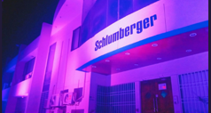

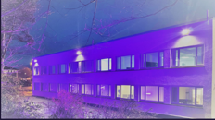
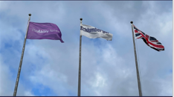
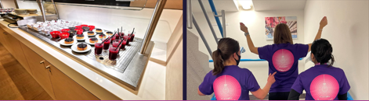
#PurpleLightUp Impact Case Study

Slide 2
SLB
SLB
SLB (NYSE: SLB) is a global technology company driving energy innovation for a balanced planet. With a global presence in more than 100 countries and employees representing almost twice as many nationalities, we work each day on innovating oil and gas, delivering digital at scale, decarbonizing industries, and developing and scaling new energy systems that accelerate the energy transition. Find out more at slb.com.

Slide 3

Why we took part in #PurpleLightup
#PurpleLightUp is a game-changing global movement led by PurpleSpace. It is designed to celebrate the economic contribution of employees with disabilities and is a mark of respect to the UN International Day of Persons with Disabilities every 3rd December.
D&I campaigns and activities align with internationally recognized days.
International Day of Persons with Disabilities on December 3 was our focus, and the Purple Light Up movement gives visibility to our efforts in this area of inclusion.

Slide 4

The ThisAbility Network
Employee Resource Group (ERG) is: The ThisAbility Network
Created at the end of 2021
Global ERG
In November 2022 there were more than 500 members
The ThisAbility Network is a community to empower people with visible or non-visible disabilities, health conditions, and care givers.

Slide 5
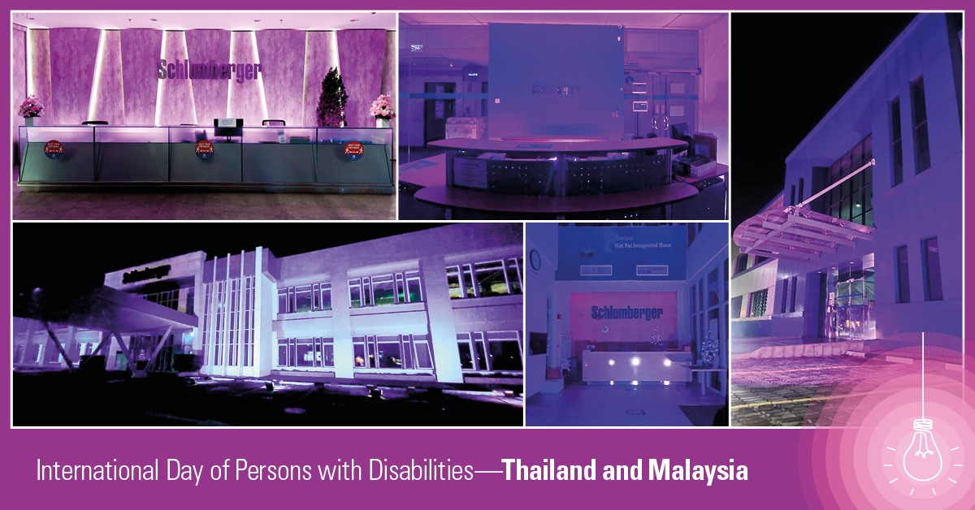
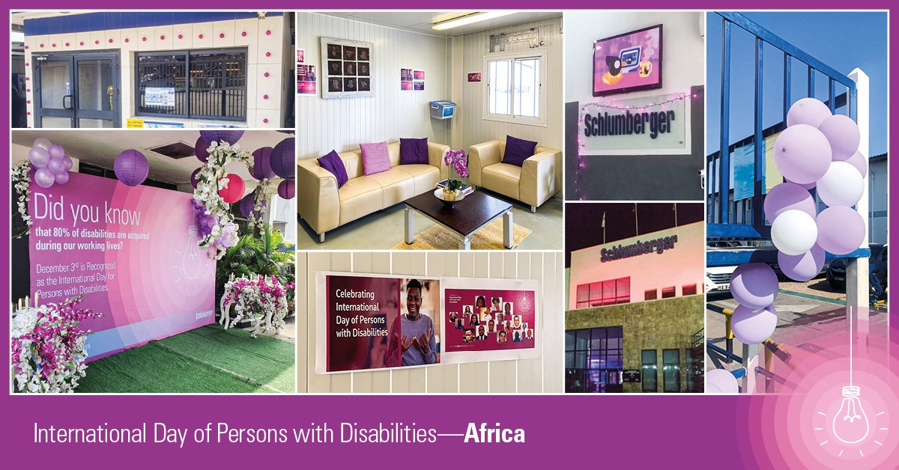
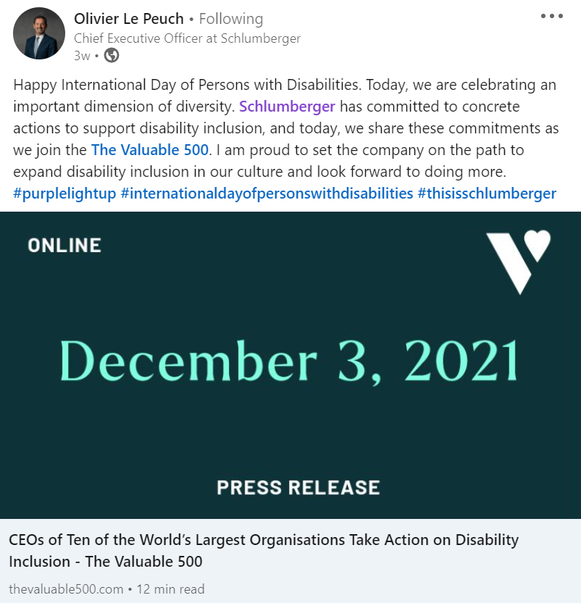
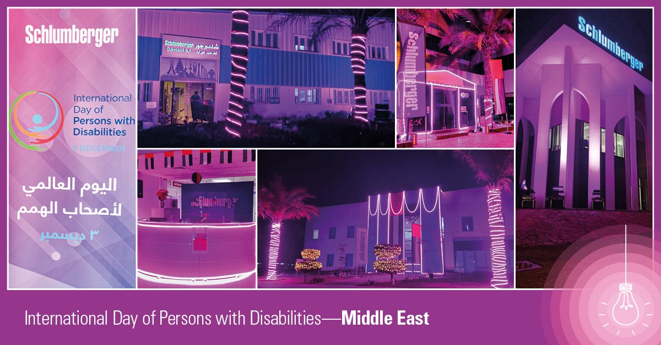
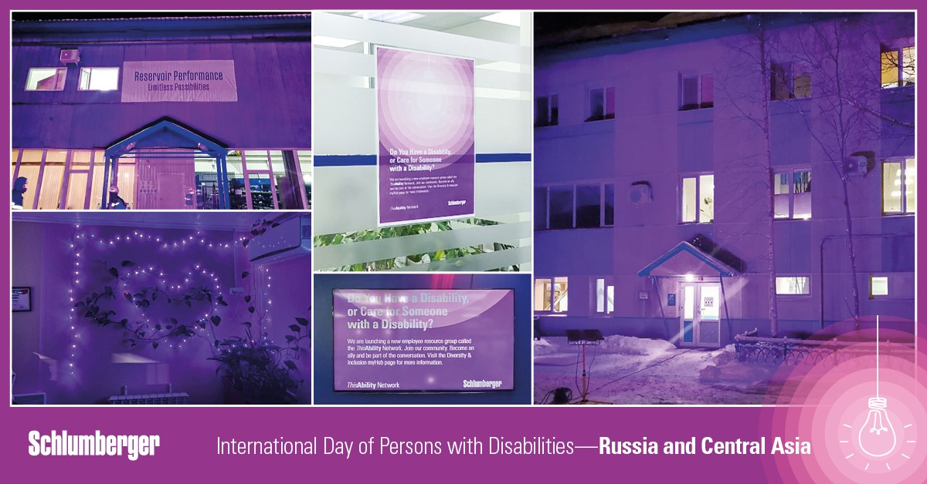
#PurpleLightUp review of impact
In 2021 we celebrated the International Day of Persons with Disabilities for the first time.
CEO made a visible external commitment to disability inclusion on LinkedIn.
  Joined the Valuable 500
#PurpleLightUp activity in 47 locations worldwide.
  Purple food
  Purple deserts
  Purple snow

Slide 6
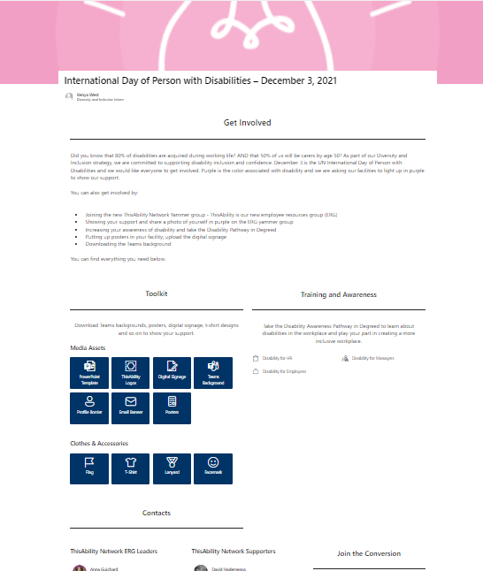
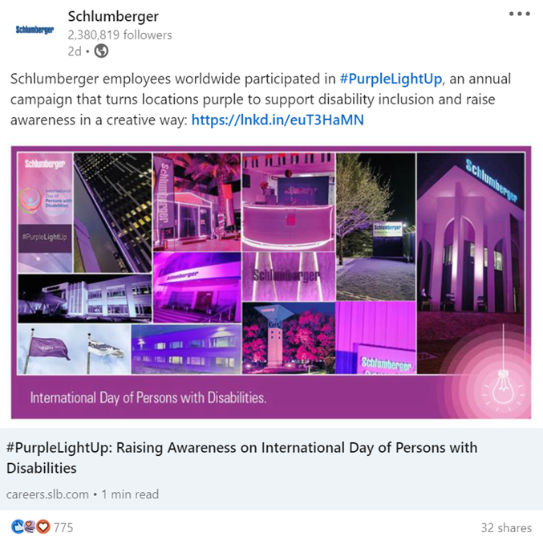
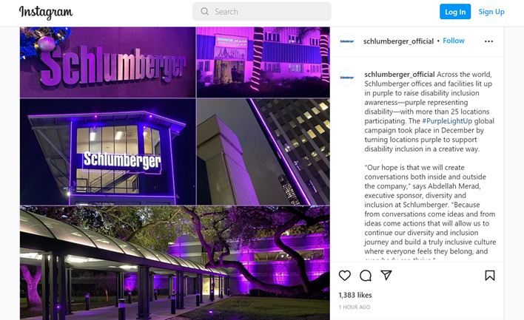
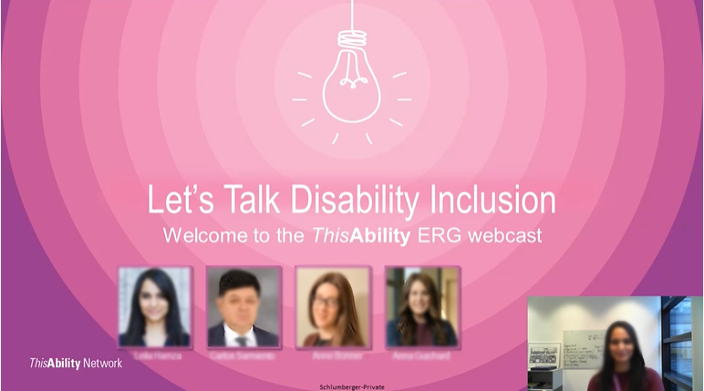
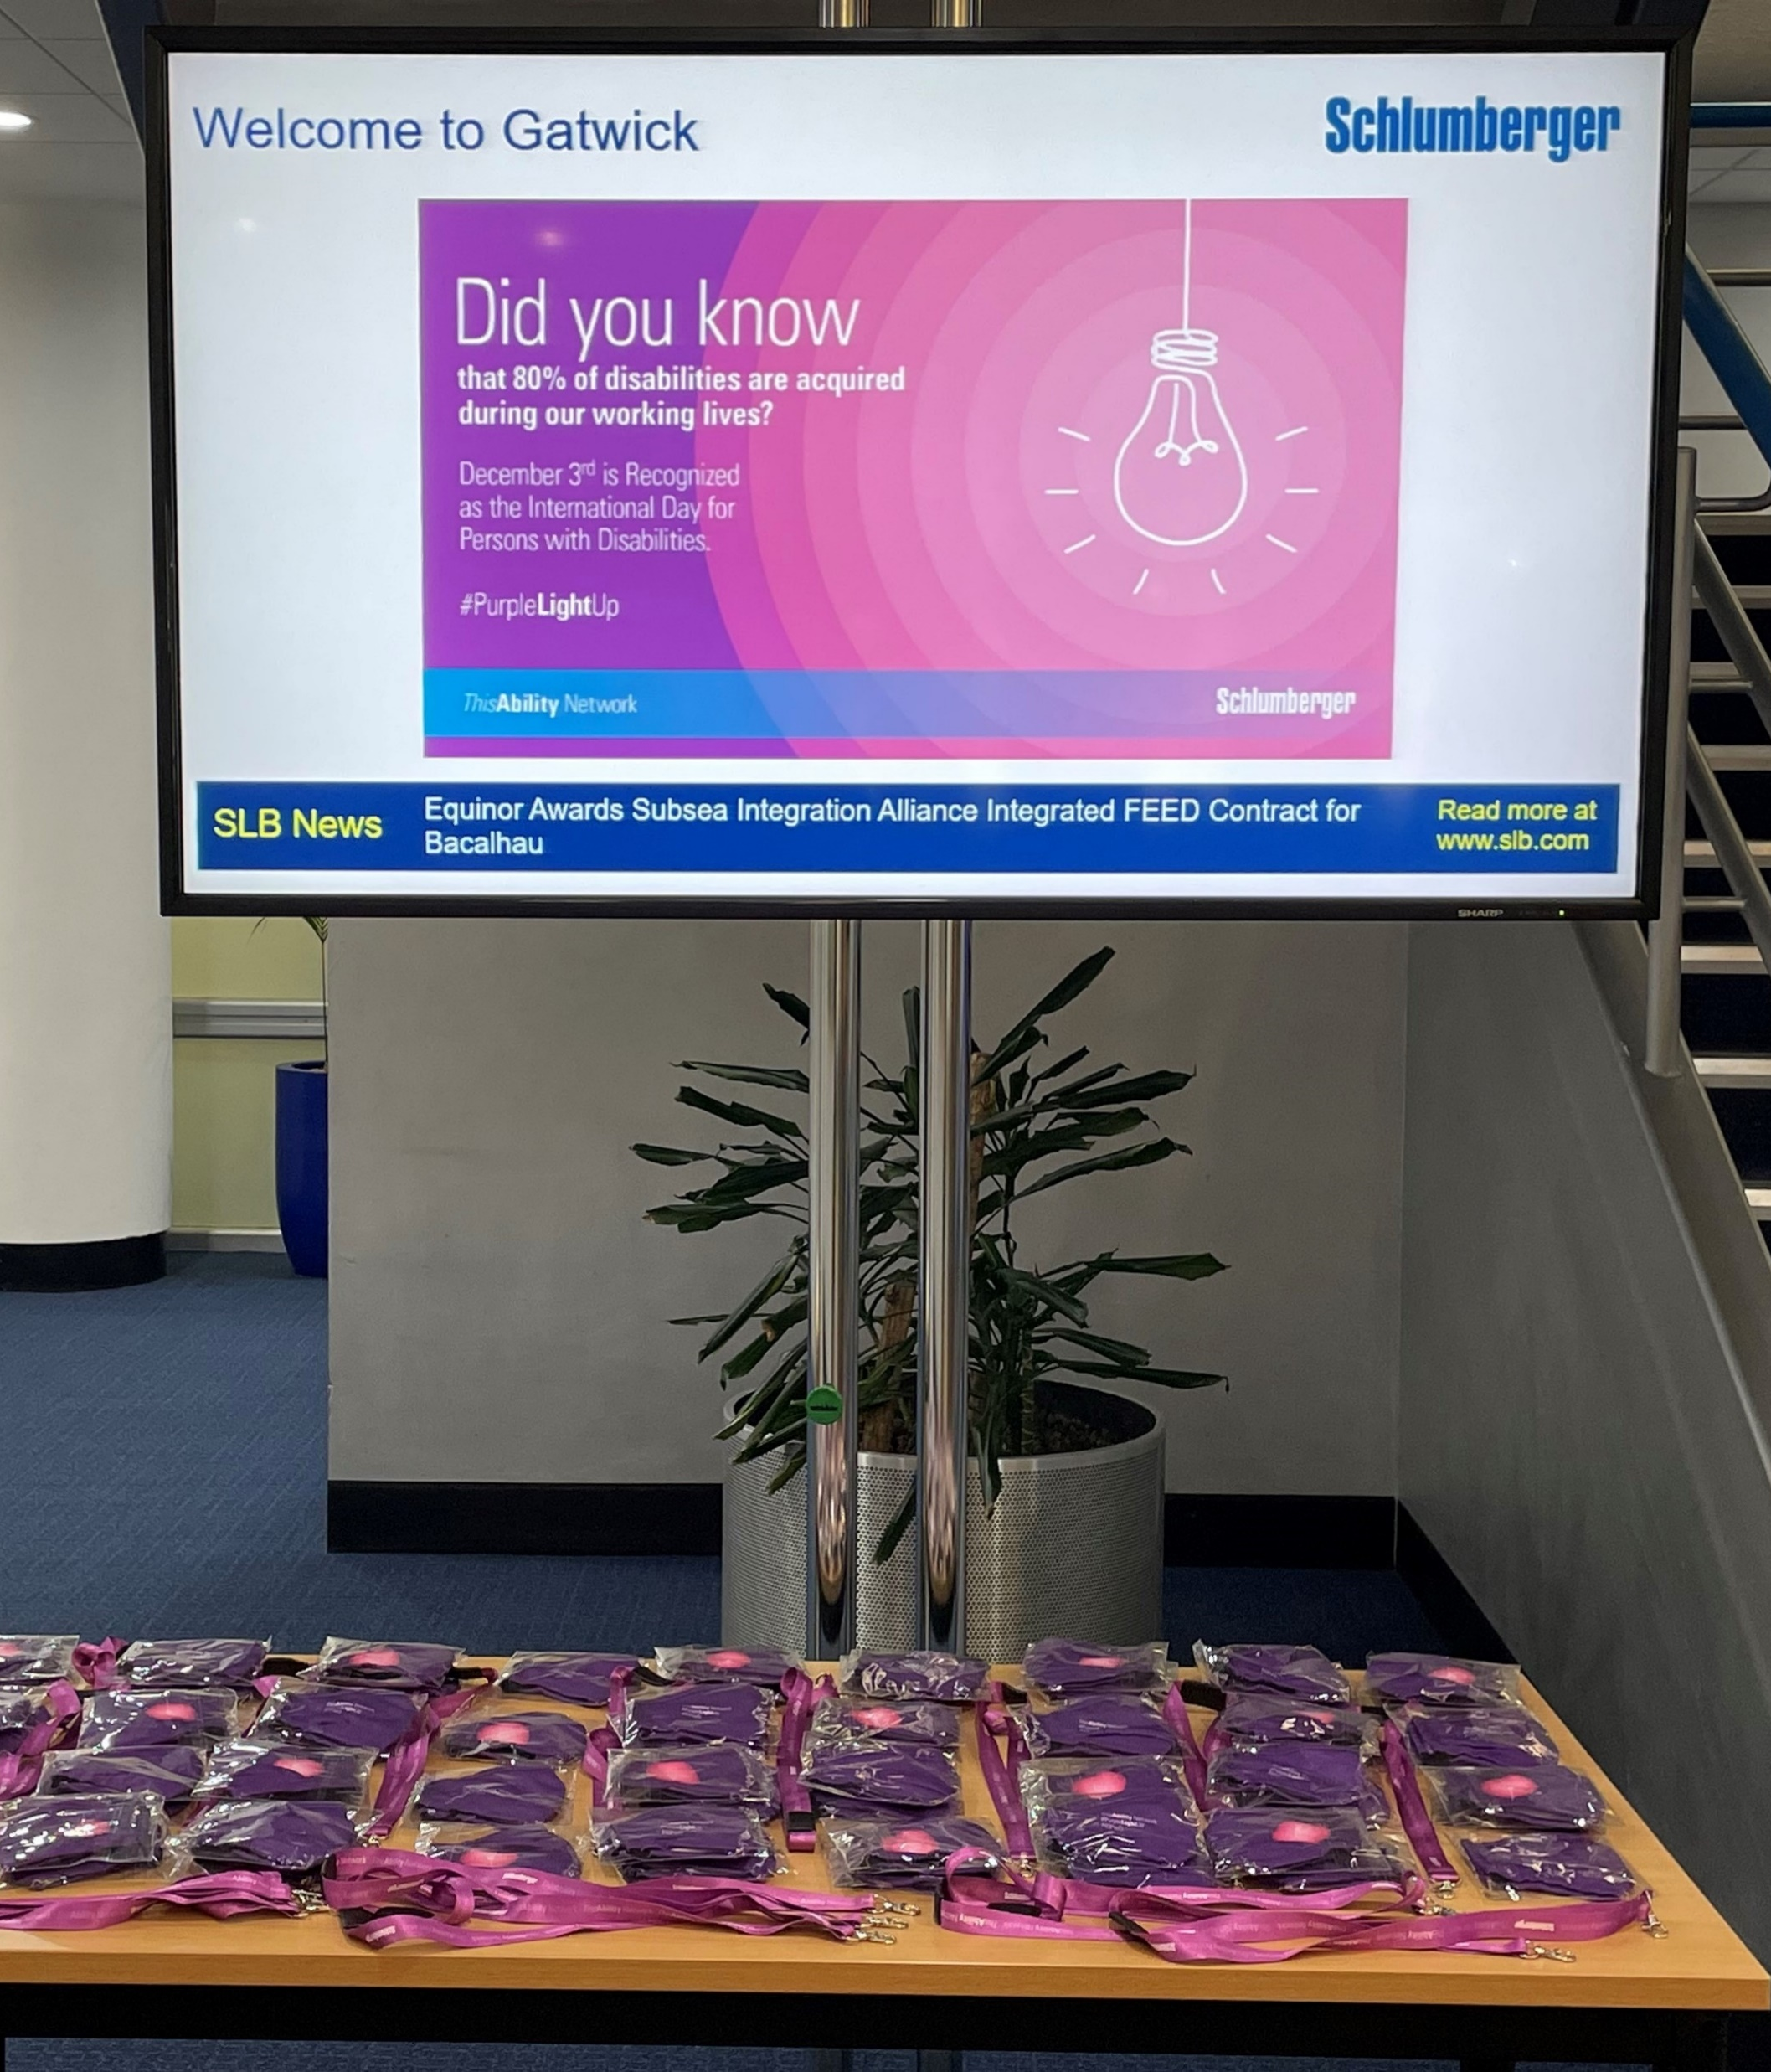
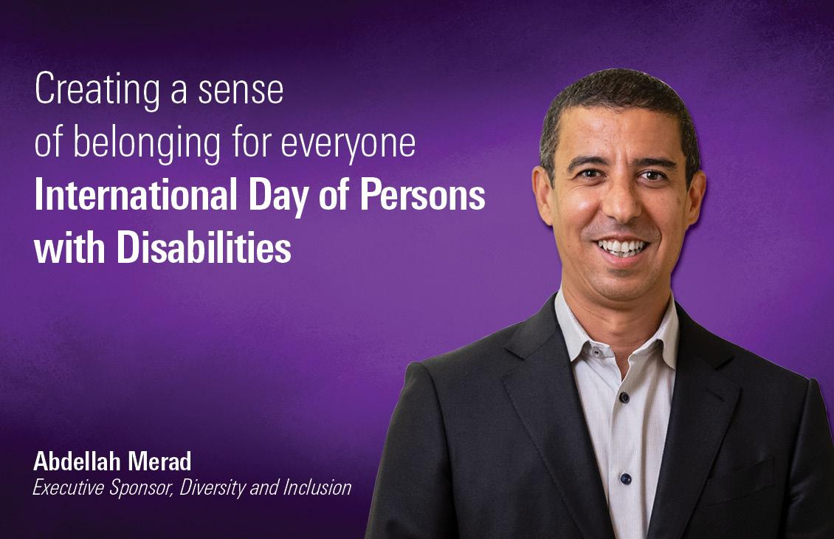
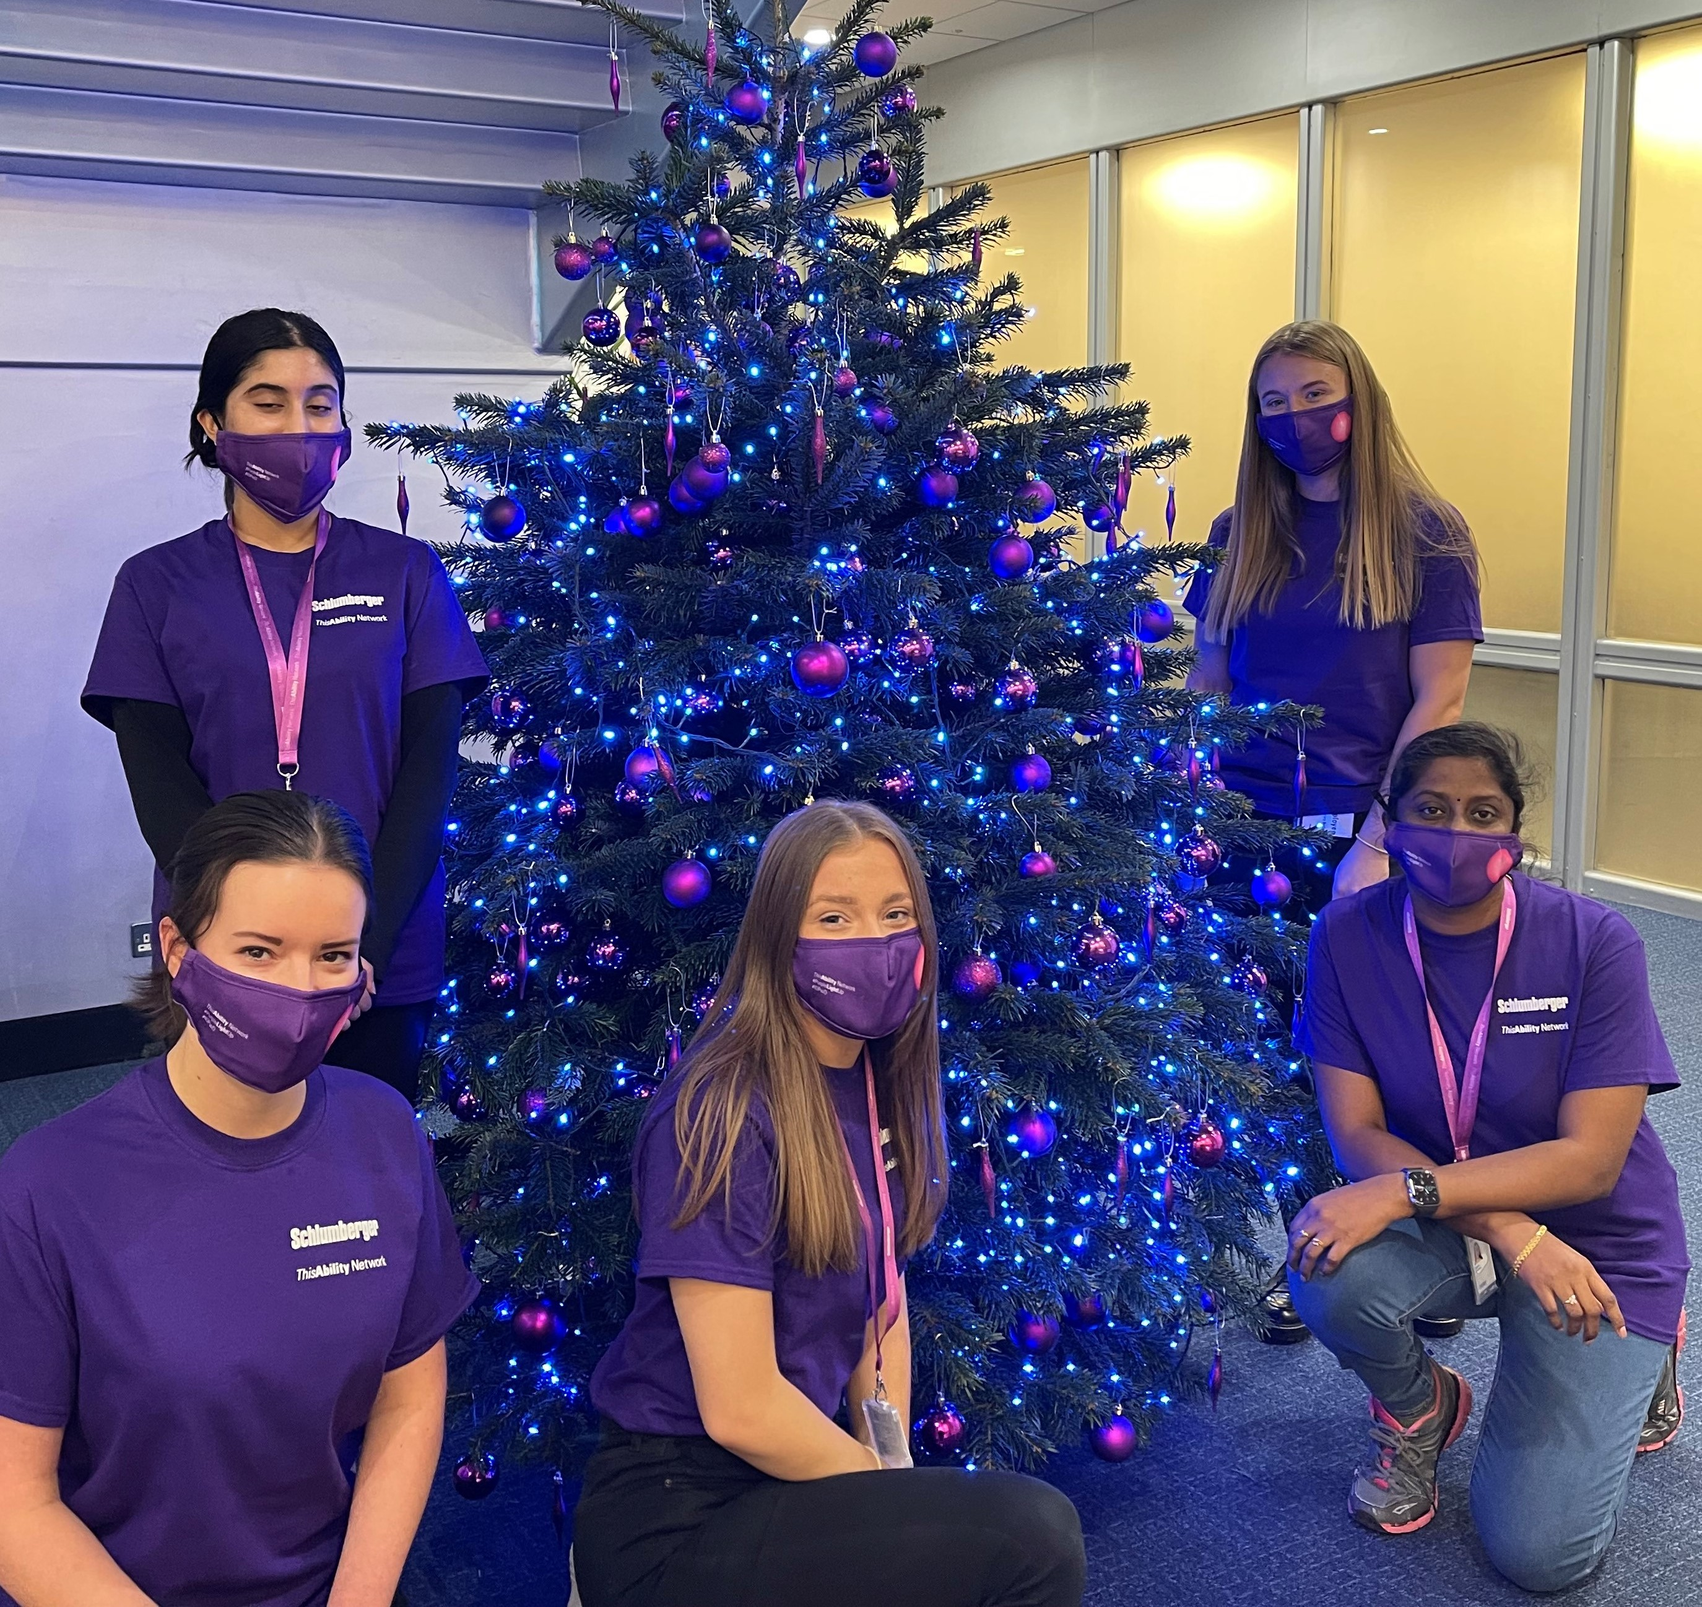
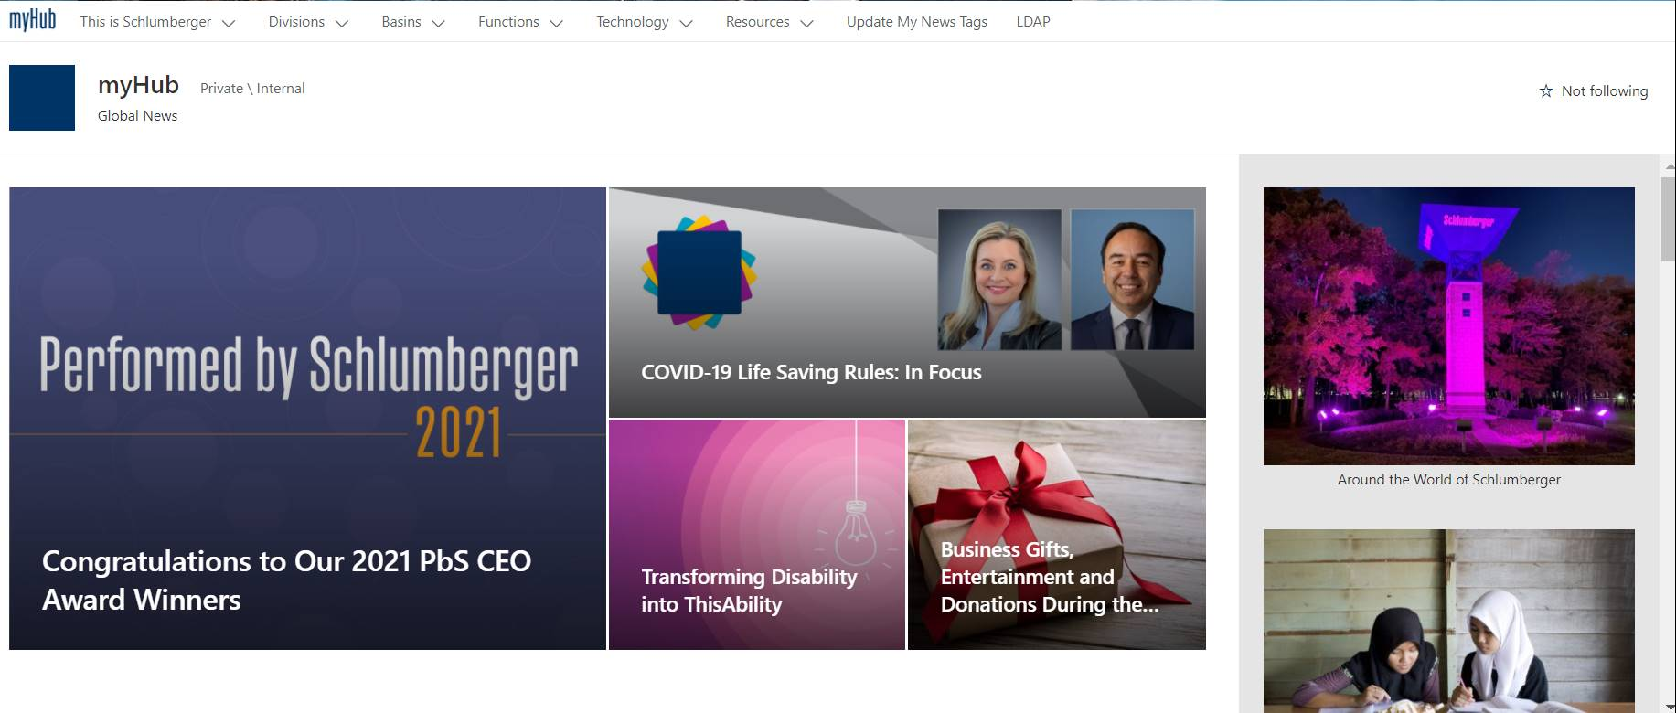
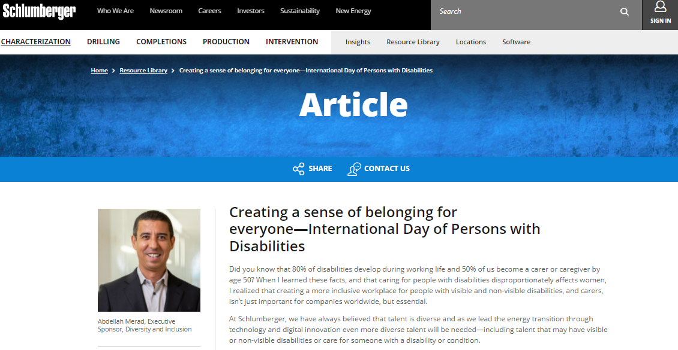
#PurpleLightUp review of Impact
Supported all activities via campaign landing page with toolkit and learning pathways for all employees
Company-wide webcast reaching over 500 people.
Social media posts around our activities and executive commitments via external articles. This included our most-liked Instagram post ever.
Internal article from our D&I Director of Diversity and Inclusion posted on our intranet.

Slide 7
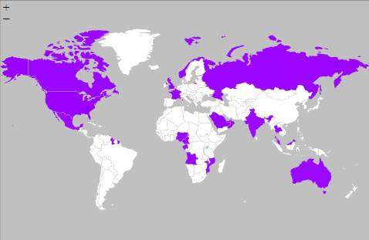
#PurpleLightUp 2021: Global reach
#PurpleLightUp activity reached 47 different offices/facilities
Activity on every continent
Countries including UK, UAE, Russia, Canada, Qatar, USA, Cameroon, Australia, Abu Dhabi, Gabon, Angola, Nigeria, KSA, Bahrain, Norway, Guyana, Thailand, Malaysia, India, Mexico, Oman, France, Trinidad, Mozambique.

Slide 8
Leader-to-Leader review
Our Leader-to-Leader event also served to formally launch the global ERG.
Our exec sponsor of the new ERG discussed the challenges of working with a disability with our head of Diversity and Inclusion and our two ERG leaders.
Each gave their own lived experience as a person with a disability, a caregiver, or as an ally.

Slide 9
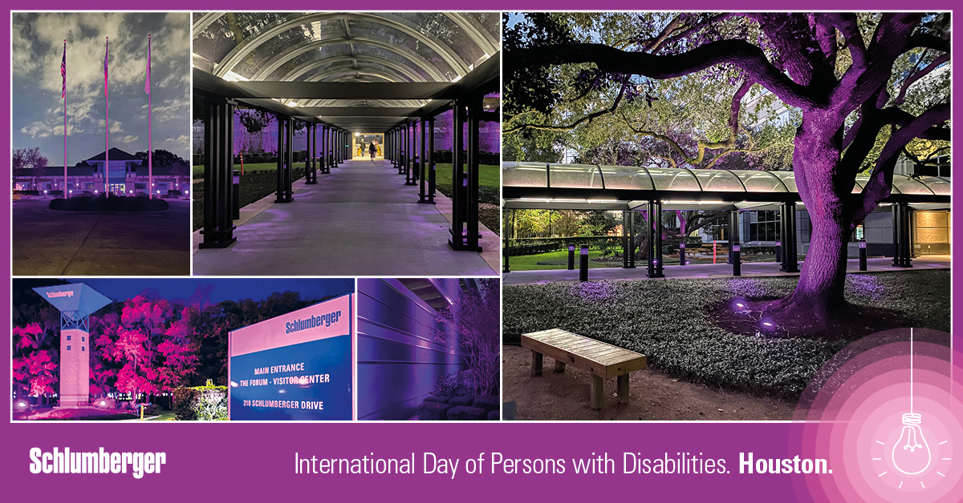
Network plan for 2022
Consolidate launch through continued awareness and education campaigns –specifically on neurodiversity, through articles and webcasts
We added a co-leader to support the ERG
Outreach with the community based on science education
Initiating local chapters in key locations
Continue to support/inform the corporate ability taskforce planning

Slide 10
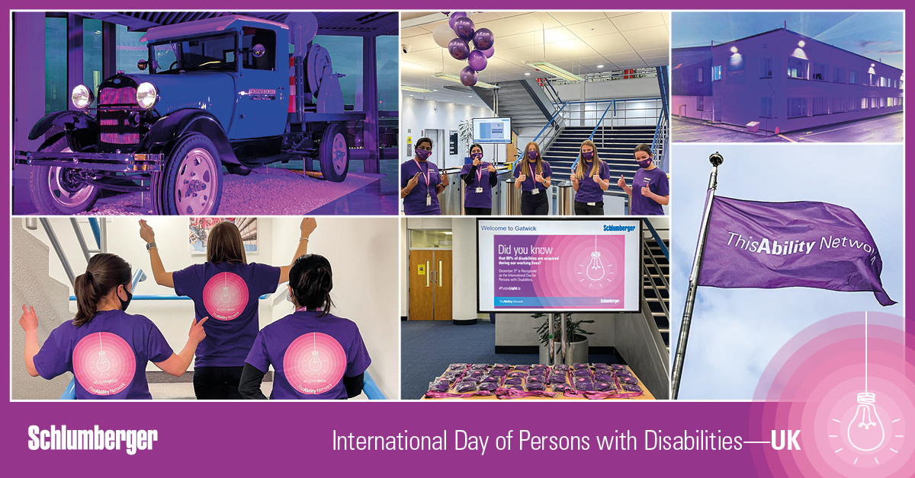
#PurpleLightUp plans 2022
We aim to expand our purple light up efforts for 2022 to reach more of our locations
Specific purple light-up content on our careers website
Annual campaign will continue through our Yammer group
Time external posts on outreach for Dec 3

