Slide 1
#PurpleLightUp
Storyboard
2021

Slide 2



#PurpleLightUp
About the Movement
#PurpleLightUp is a game-changing global movement led by PurpleSpace. It is designed to celebrate the economic contribution of employees with disabilities and is a mark of respect to the UN International Day of Persons with Disabilities every 3rd December.
#PurpleLightUp enables disability Employee Resource Groups / networks and their employers to accelerate culture change around the world.
Organisations that participate in #PurpleLightUp are signalling one, or more, of the following:
Their disability Employee Resource Group/Network matters to them and they value their leadership, challenge and innovation.
They are an ally to people with disabilities.
Disability is on their board agenda.

Slide 3
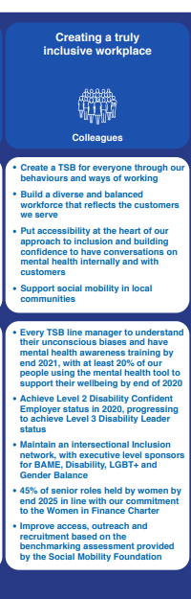
Who We Are - TSB
TSB is a UK retail bank with a trusted customer brand, heritage stretching back to the start of the savings bank movement 200 years ago, and a committed workforce that offer full service banking to more than five million customers.
At TSB we believe our business should reflect the communities we serve. For us, it’s the only way to truly meet our customer needs. Building a diverse and inclusive culture is more than just the right thing to do; it’s good for business.
So much so, that it’s one of our goals in our Do What Matters Plan – creating a truly inclusive workplace. We’re creating a TSB for everyone through our behaviours and ways of working.
“At TSB we are creating a truly inclusive workplace. That means building a diverse and balanced workforce that reflects the customers we serve. We believe a truly inclusive culture is somewhere you feel you belong. And which values the difference you bring”
TSB HR Director and ability network Exec Sponsor Liz Ashford

Slide 4
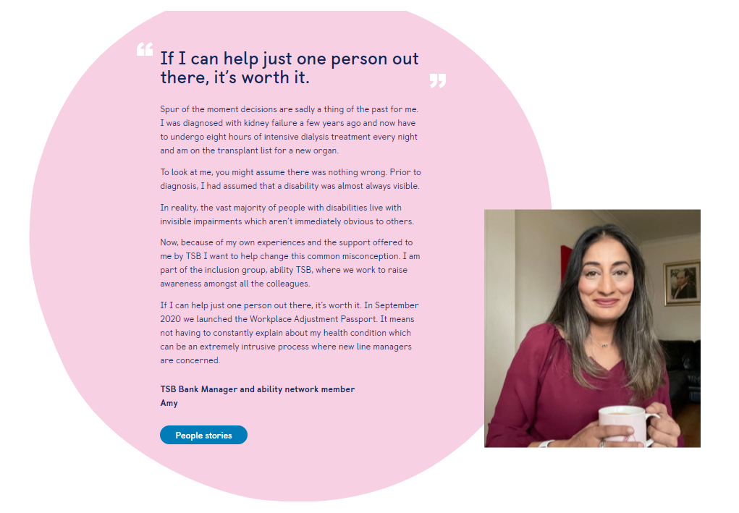

Who We Are – Ability at TSB
Ability at TSB
Ability at TSB is part of the wider Inclusion Network which brings together colleagues and allies to support and promote a culture of inclusion.
As well as providing support to help colleagues manage disabilities and health conditions in the workplace, we understand that combining caring responsibilities with work is often challenging. We’ve partnered with Carers UK and launched our Carer Policy to offer a range of support including up to 70 hours paid leave for carers.

Slide 5
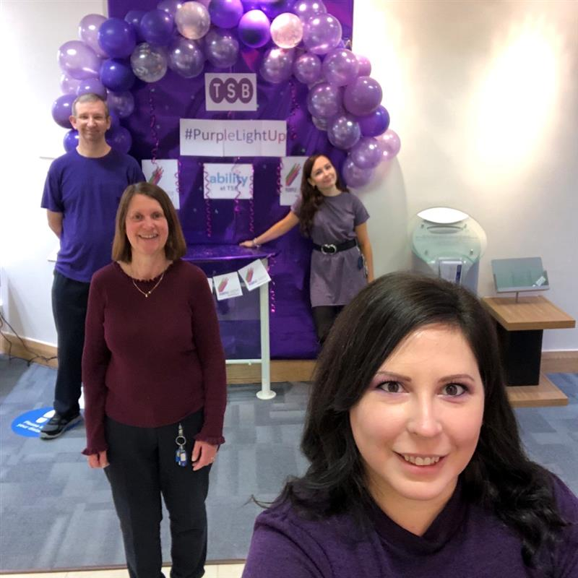
Why #PurpleLightUp?
Over the last couple of years, ability at TSB has focused on delivering three key events in the year.
We understand and value the contribution that disabled employees make to TSB. #PurpleLightUp is the pinnacle of our calendar. The day offers a brilliant occasion for everyone, across the whole organisation, to get involved in raising awareness, shine a light on all the great work throughout the year, and support TSB’s ability network.
It is a great way to wrap-up the year up, celebrate our achievements, look ahead to the following year, and encourage more people to join as network members or allies. #PurpleLightUp gives us a welcome boost at the end of each year.
“As one of the 386 million disabled employees across the globe, I wanted to get involved with #purplelightup to see it get the coverage it deserves. After all, the herculean effort disabled people across the world are putting in to stay in work deserves to be celebrated! I am grateful I’ve been given the opportunity and I am committed to getting as many people involved as possible”
TSB Money Confidence Expert and ability network co-chair Suzanne Cassidy

Slide 6
The Impact of #PurpleLightUp
Last years activities included:
Bankwide dress down/turn purple. Our branch colleagues had the option to decorate their branches, those with digital screens had a video playing promoting PurpleLightUp, our office colleagues and those working from home had the option to use a bespoke purple background created for us.
Internal podcasts on non visible disabilities and vulnerable customers alongside an interview with some very special external guests.
Network rebrand – we changed our name to ability and launched our new internal communications page.
A raft of internal communications, over a week, featuring stories to celebrate and raise awareness, and encouraging people to join the conversation on Yammer.
Two colleague profiles posted on LinkedIn.
Because of this, more and more people get involved year on year:
  In our branches, each region had 5-10 champions who spoke about #PurpleLightUp with their teams, decorated their branches and encouraged a purple ‘dress down’ day.
  The bank executive embraced the #PurpleLightUp Teams background and used it on the Senior Leader call that day.
  We saw a 40% increase, from 2019 to 2020, of people joining the conversation on Yammer with #PurpleLightUp posts. And in our branches that went up by a massive 179%
  We saw an increase in those who wanted to support the network.
This engagement and culture of acceptance has paved the way for our #SpeakUp story telling campaign which we launched earlier this year as part of our ‘ability month’ activities. Colleagues have shared their personal stories on how their disability has affected them. Our #SpeakUp posts are the most engaged with on Yammer.

Slide 7
Our Aims for #PurpleLightUp 2021
Our aim is to build on last year’s activities and engagement. Go bigger and better!
We are currently in our planning phase. Initial ideas include:
Purple Buildings – we are liaising with our property team to explore the possibility of purple buildings
External speaker – we are working with our ethnicity network to deliver an intersectional external speaker event
Objectives:
To raise awareness of the issues faced by people of disability across the UK​
To demonstrate TSB’s commitment to diversity and inclusion ​
To showcase and champion the voices of those within the ability network ​
To work with partners such as PurpleSpace and external speakers to provide a united front in support of those with disabilities ​
To encourage colleagues with disability to build inner confidence, feel supported and part of an inclusive organisation

Slide 8
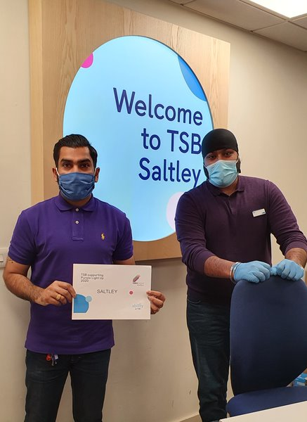
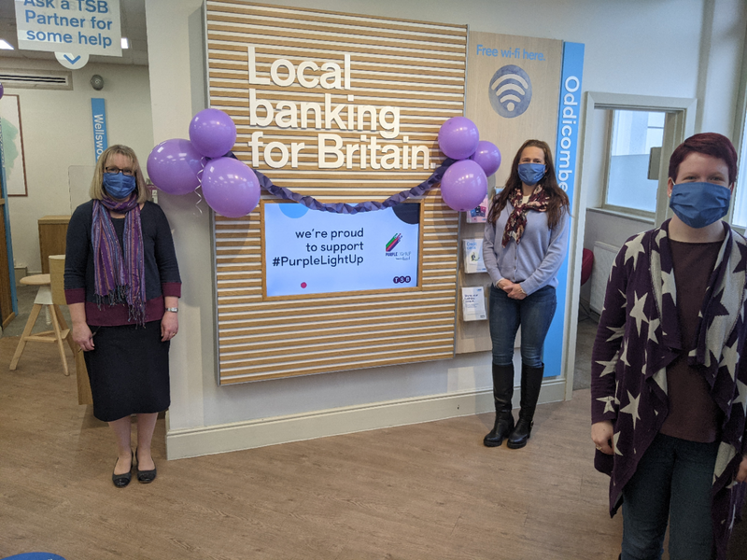
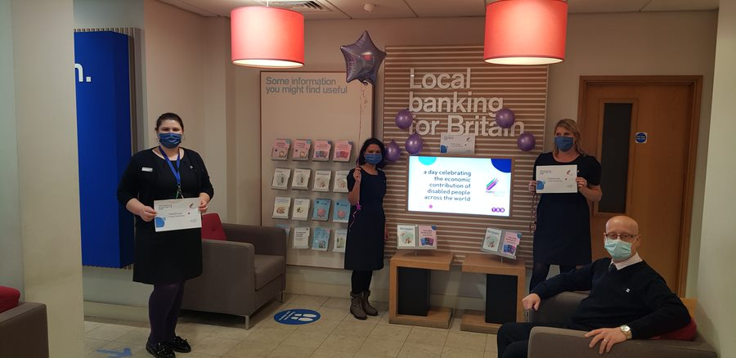
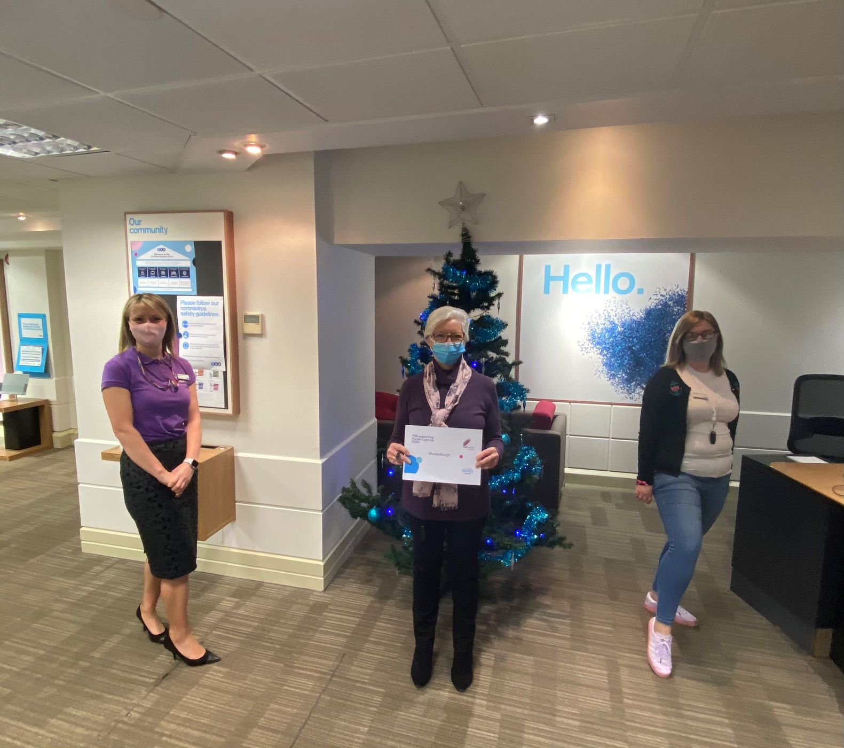
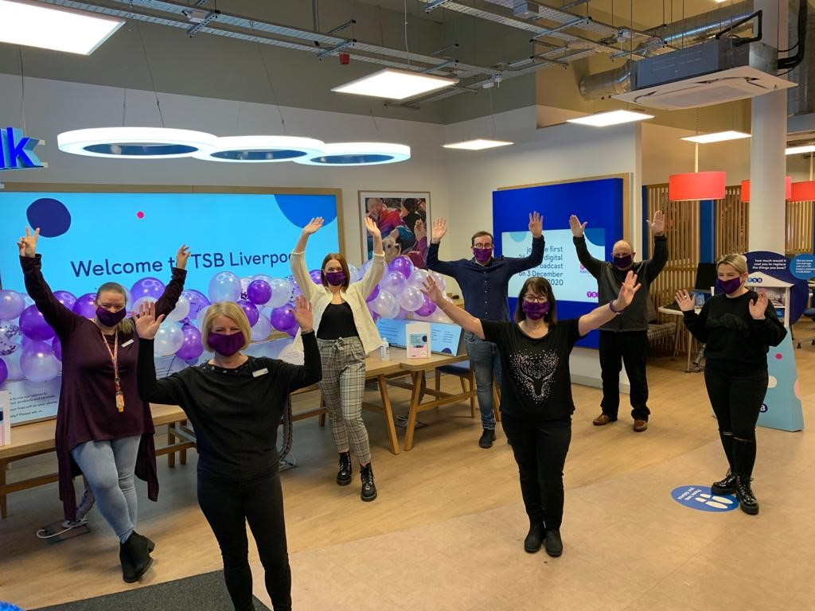
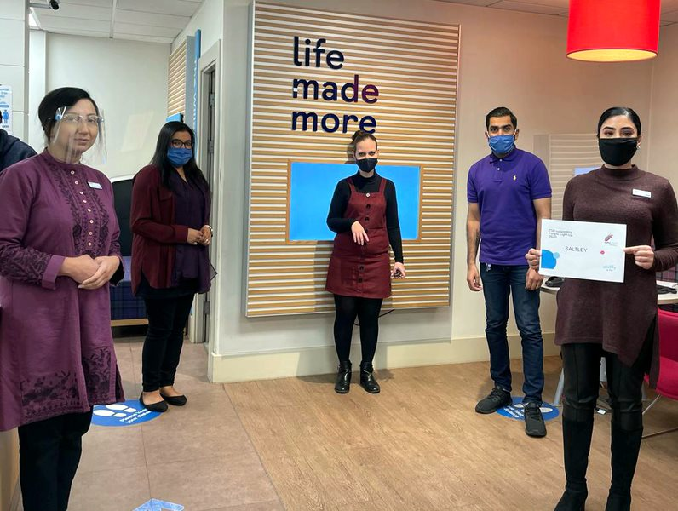
TSB Turns Purple

Slide 9

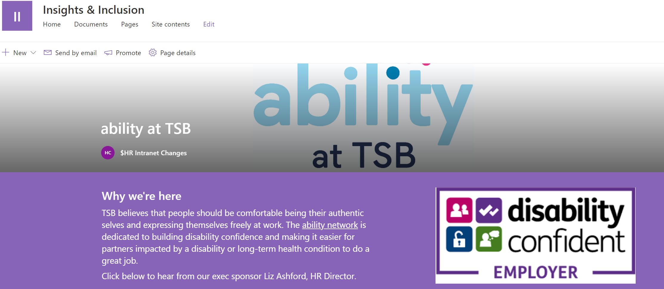
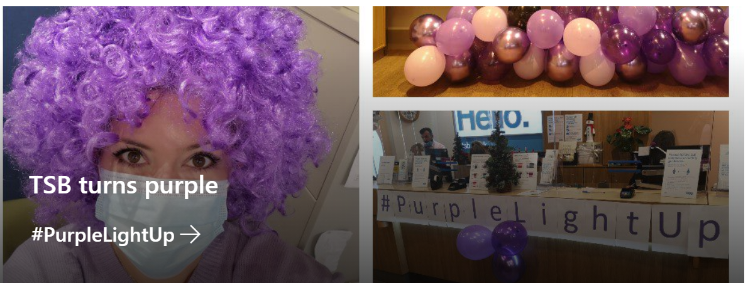
TSB Turns Purple
Ability intranet page launched
Teams background for all to use
Intranet stories throughout the week
Network rebrand

Slide 10


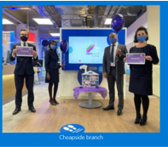


Branch Digital Boards

Slide 11
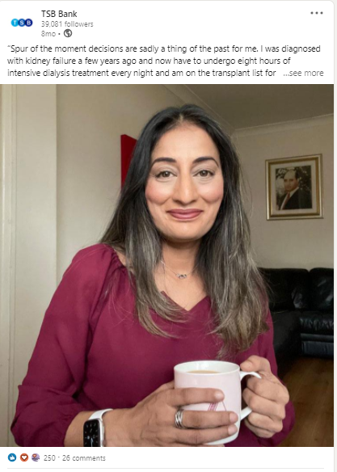
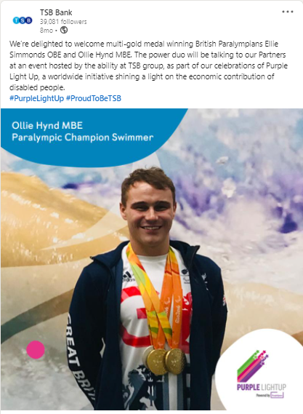
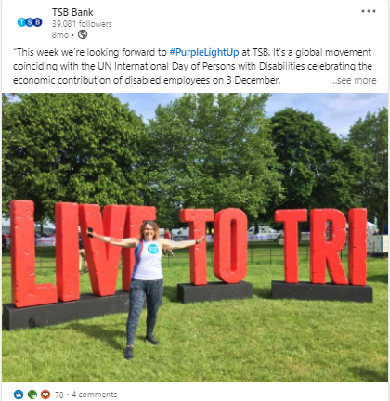
LinkedIn Activity

Slide 12

PurpleSpace
Contact Details
#PurpleLightUp: https://www.purplespace.org/purple-light-up
PurpleSpace website: www.purplespace.org
Email: hello@purplespace.org
Twitter: @mypurplespace
LinkedIn: linkedin.com/company/purplespace
Facebook: facebook.com/mypurplespace
Building disability confidence from the inside out

