Slide 1
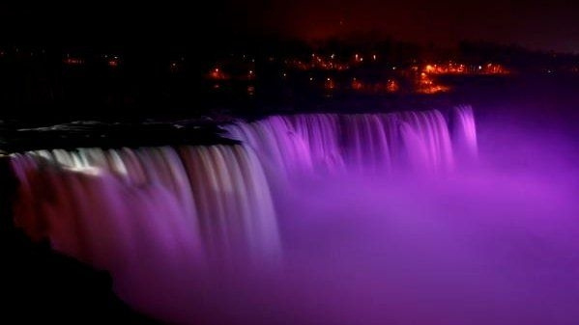


Introduction to PLU
#PurpleLightUp is a game-changing global movement led by PurpleSpace. It is designed to celebrate the economic contribution of employees with disabilities and is a mark of respect to the UN International Day of Persons with Disabilities every 3rd December.
#PurpleLightUp enables disability Employee Resource Groups / networks and their employers to accelerate culture change around the world.
Organisations that participate in #PurpleLightUp are signalling one, or more, of the following:
Their disability Employee Resource Group/Network matters to them and they value their leadership, challenge and innovation.
They are an ally to people with disabilities.
Disability is on their board agenda.

Slide 2

Parliament of Austria
Austria is a federal parliamentary republic
The Parliament
consists of the
National & the Federal Councils,
which meet in the Austrian Parlament Building
in Vienna.
# PurpleLightUp Storyboard 2021

Slide 3
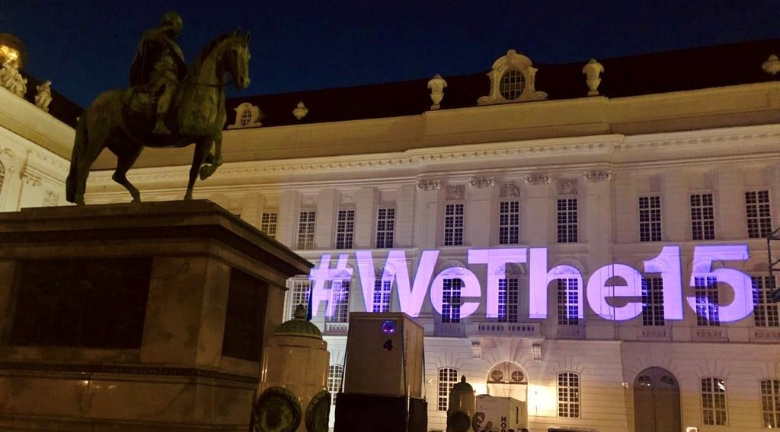
We participate because
We joined the #PurpleLightUp movement to raise awareness of our commitment to disability equality and inclusion as an employer and as the heart of democracy in Austria.
We want to inform Austrian citizens that we back equal rights for disabled people

Slide 4
We participate because
The Austrian Parliament, as the heart of democracy in Austria, is focused on inclusion , particularly as it enables participation in our democratic processes.
Since Wolfgang Sobotka became President of the National Council in December 2017, the parliament has sought to raise the profile of this important topic in Austria.
Parliament supports several initiatives, organizes events, promotes networking for an inclusive society and will exceed regulatory requirements as we renovate the parliament buildings for employees and visitors, from 2022.

Slide 5
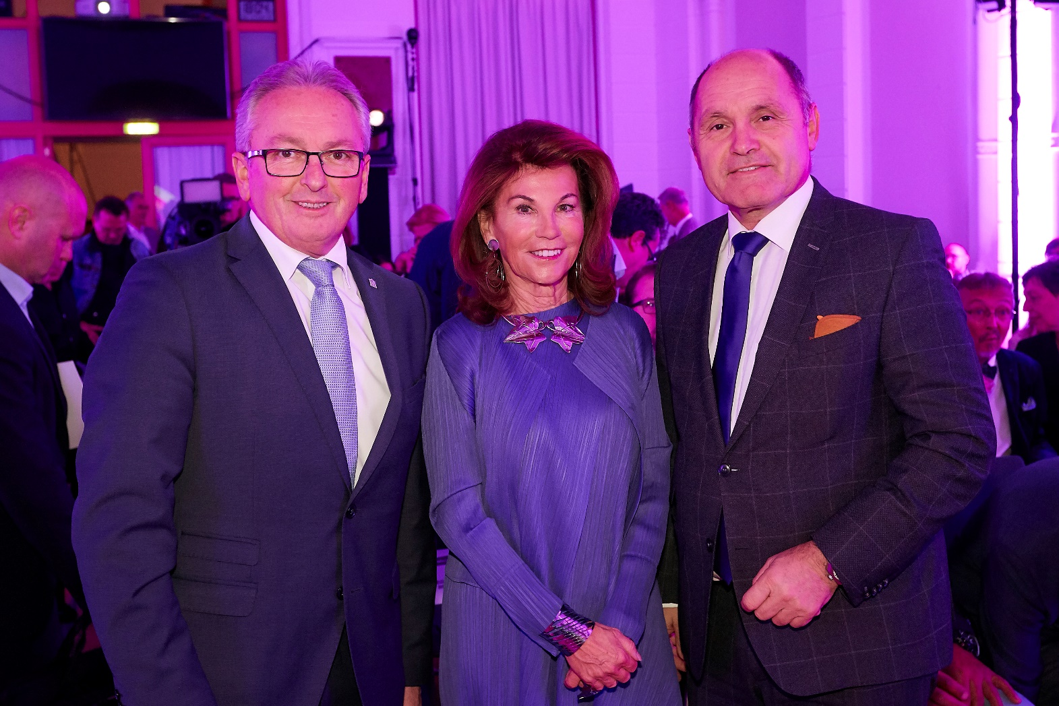
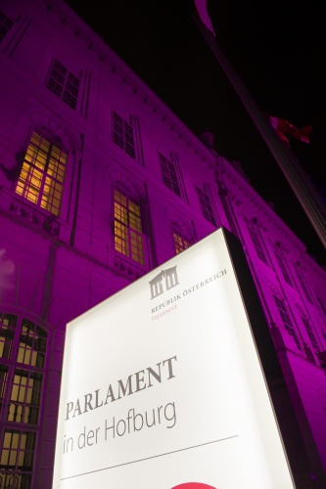
Former President of the Federal Council Mr. Bader & former Chancellor Ms. Bierlein, guests of President of the National Council, Mr. Wolfgang Sobotka, at #PurpleLightUp 2019

Slide 6
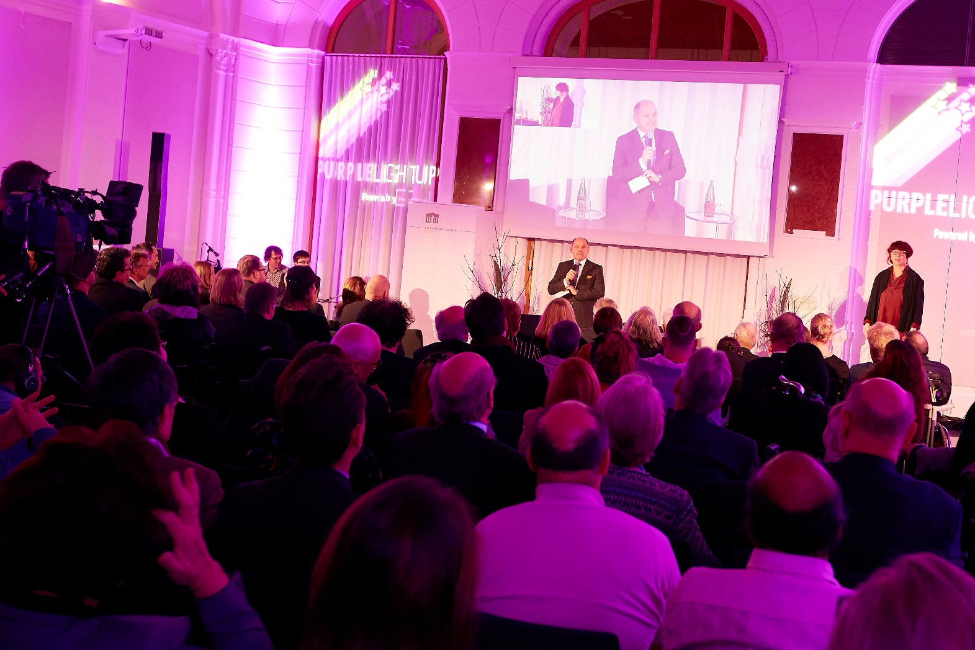
#PurpleLightUp 2019: many guests, including senior business leaders, leaders with disabilties, public authorities, and civil society…

Slide 7
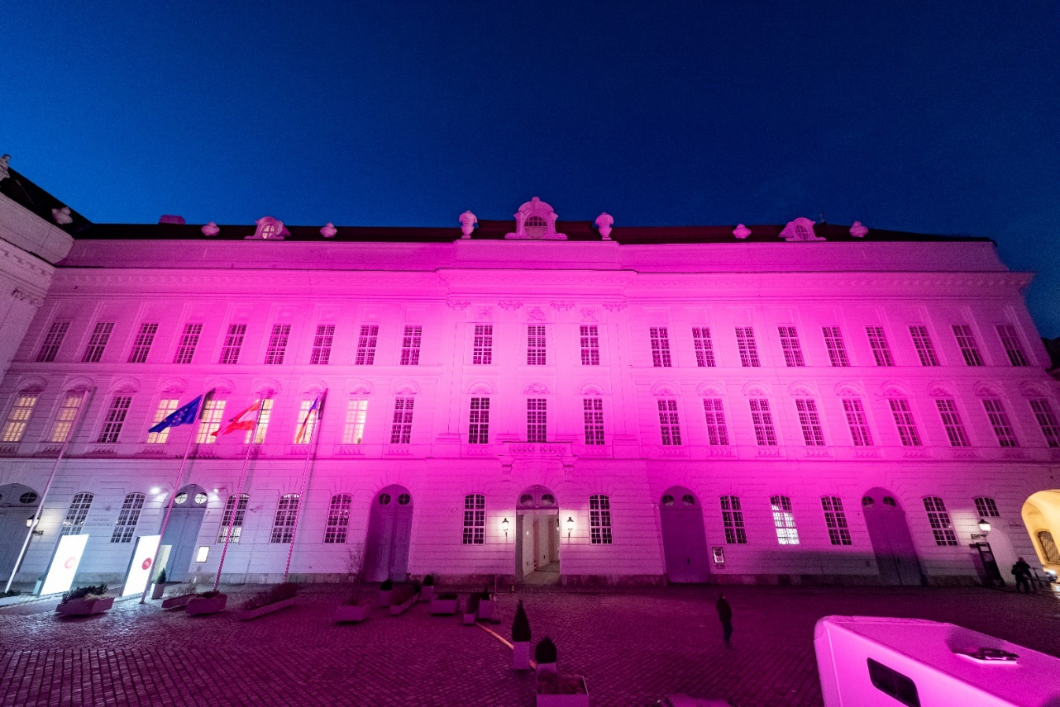
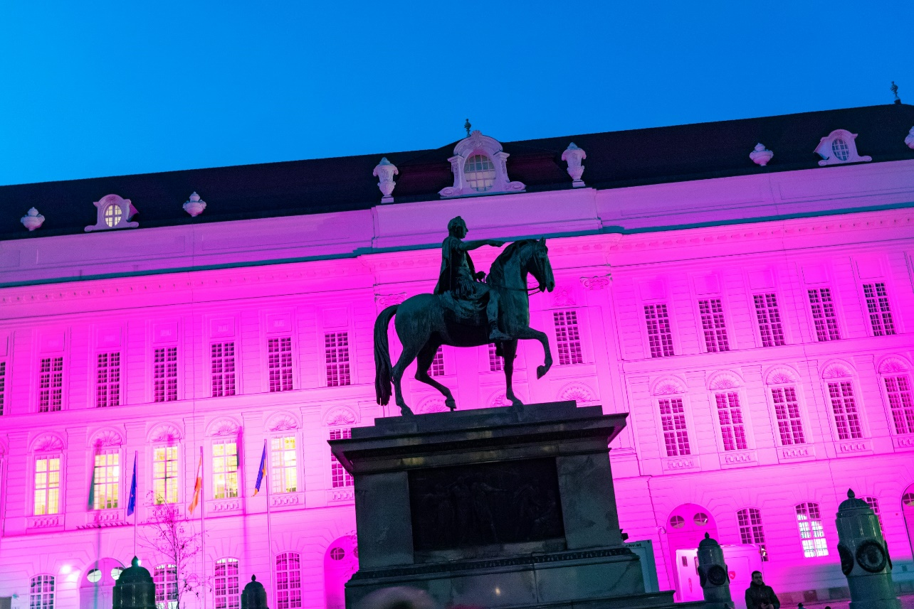
…. purple illuminated Parliament!

Slide 8
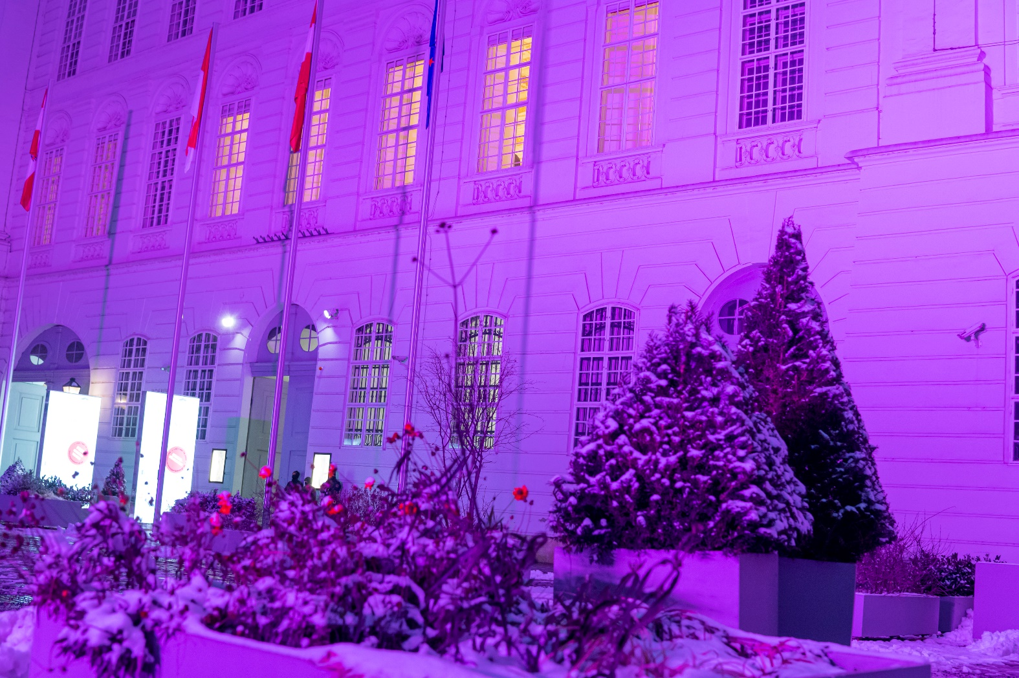
Parliament was only one of many illuminated buildings in Vienna, December 2020

Slide 9
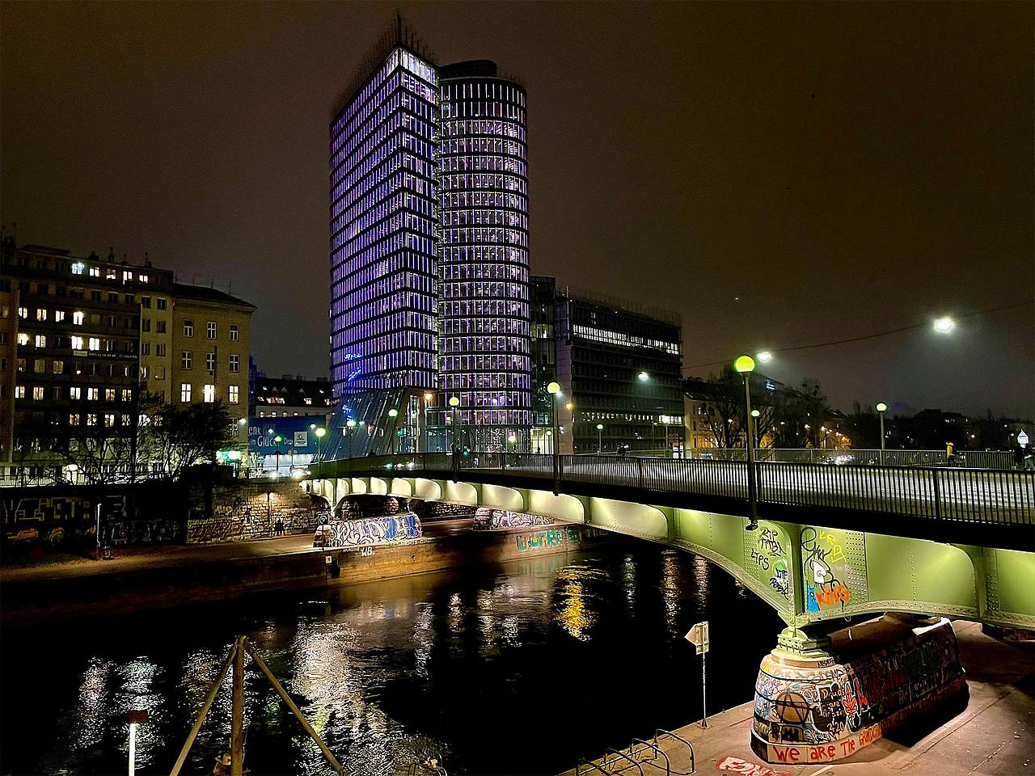
UNIQA Tower at Donaukanal, Uniqa is one of Austria‘s largest financial institutions.

Slide 10
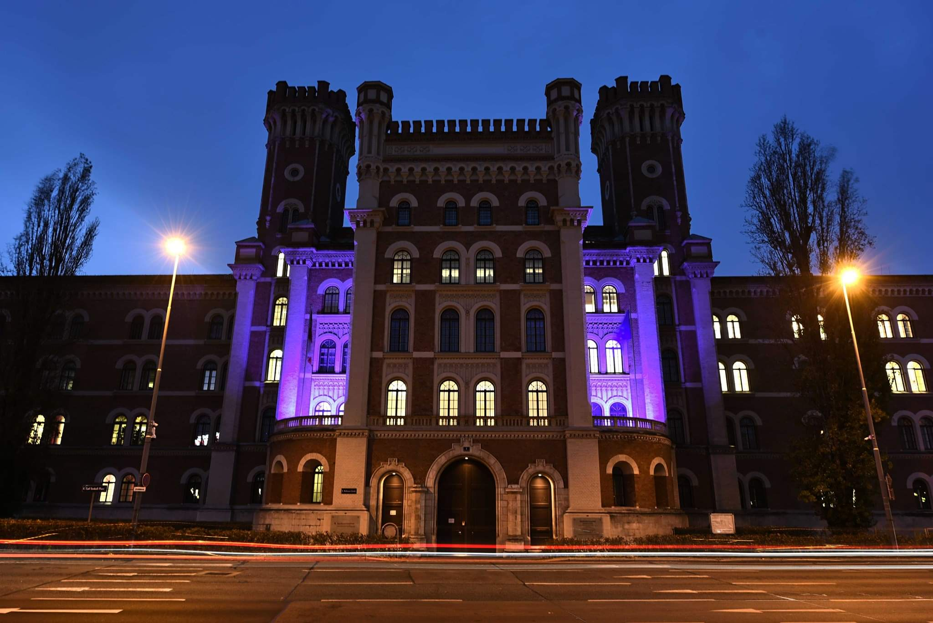
Federal Ministry of National Defence

Slide 11
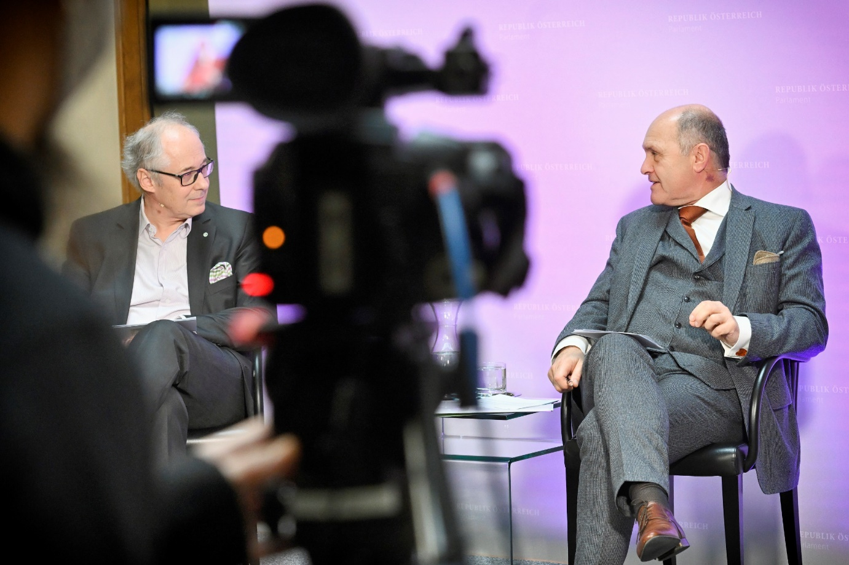
We also partner with the Zero Project of the Essl Foundation…Martin Essl is himself an enthusiastic supporter of the #PurpleLightUp movement!
Martin Essel (Zero Project) and Wolfgang Sobotka

Slide 12
The impact of our participation in #PurpleLightUp
We see greater interest across the organisation in learning more about disability
We are investing in barrier-free infrastructure for employees and visitors
As an employer we have consulted on the need for greater accessibility and are building our strategy to become a truly inclusive workplace

Slide 13
Our plans for the future
Events on disability equality and inclusion for parliamentarians and stakeholders
Company and government visits with focus on inclusion
We plan to ensure that 15% of our traineeships go to persons with disabilties
October 2022: Will see completion of the renovated and barrier-free Parliament with its multi-sensory visitor centre
December 3, 2021 we will again GO PURPLE!

Slide 14

#PurpleLightUp: https://www.purplespace.org/purple-light-up
PurpleSpace website: www.purplespace.org
Email: hello@purplespace.org
Twitter: @mypurplespace
LinkedIn: linkedin.com/company/purplespace
Facebook: facebook.com/mypurplespace
Building disability confidence from the inside out

