Slide 1
HSBC Purple Light Up 2021
2021

Slide 2



#PurpleLightUp is a game-changing global movement led by PurpleSpace. It is designed to celebrate the economic contribution of employees with disabilities and is a mark of respect to the UN International Day of Persons with Disabilities every 3rd December.
#PurpleLightUp enables disability Employee Resource Groups / networks and their employers to accelerate culture change around the world.
Organisations that participate in #PurpleLightUp are signalling one, or more, of the following:
Their disability Employee Resource Group/Network matters to them and they value their leadership, challenge and innovation.
They are an ally to people with disabilities.
Disability is on their board agenda.

Slide 3
HSBC’s Purple Light Up objectives
HSBC is one of PurpleSpace’s Strategic Partners and participating in #PurpleLightUp is a key date in our Inclusion calendar
We share the ambition of using #PurpleLightUp to raise awareness and celebrate the contribution that people with disabilities make to businesses around the world
We seek to demystify the lived experiences of those with disabilities/differences in mental and physical health and encourage allyship and understanding
In 2019 we celebrated #PurpleLightUp for the first time lighting up in the UK, US and Mexico
In 2020, despite the challenges of the Pandemic we expanded our participation across 11 locations with a huge range of activities and buildings lit up from Vancouver to Hong Kong
In 2021 we aim to go further still!
On December 3 we aim to bring a splash of purple into as many of our colleagues’ day as we can by:
  Lighting up our buildings
  Involving our branch staff to help raise awareness in the communities we serve
  Using our Zoom backdrop during meetings
  Encouraging colleagues to participate in employee network events
  Working with other organisations in our business network to have their buildings or local landmarks lit up
  Using #PurpleLightUp on social media such as Linked In

Slide 4
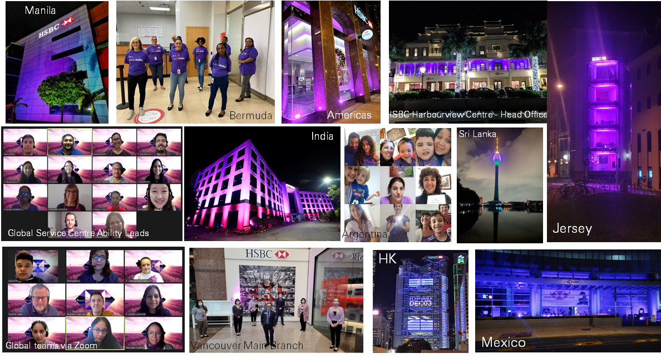

“Last year 11 HSBC locations from Vancouver to Hong Kong joined in the #PurpleSpaceLightUp, and in 2021 we aim to grow participation even further – helping demystify the lived experiences of those with disabilities and differences in mental and physical health, encouraging allyship and understanding across HSBC and workplaces the world over.”
Ian Stuart, Chief Executive for HSBC UK and executive sponsor of HSBC’s global Ability Employee Network
#PurpleLightUp
2020

Slide 5
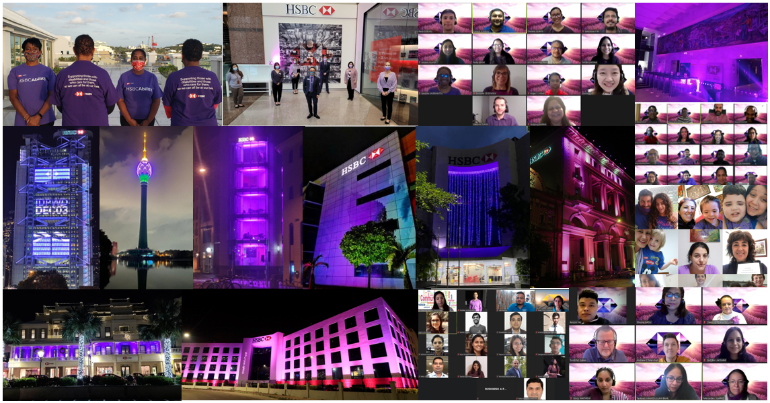
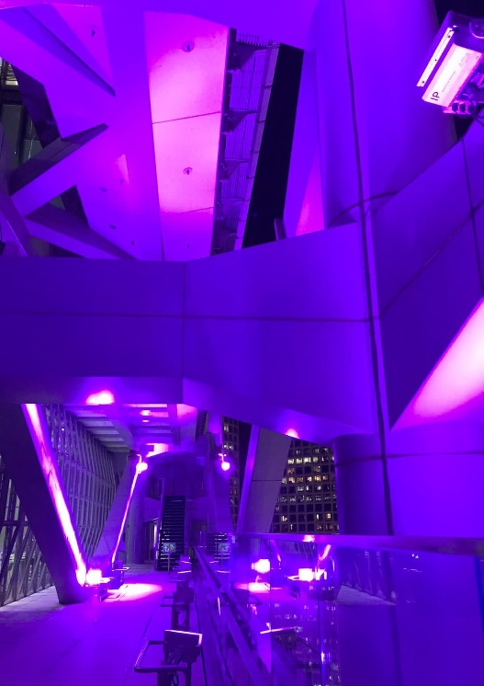
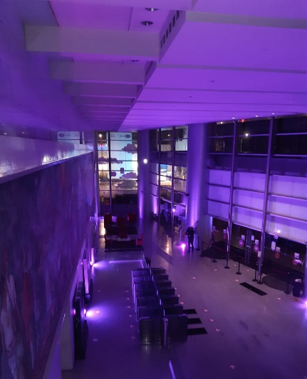
#PurpleLightUp 2020

Slide 6
About HSBC
HSBC is one of the world’s largest banking and financial services organisations. Our global businesses serve more than 40 million customers worldwide through a network that covers 64 countries and territories. We employ 226,000 full-time equivalent employees (‘FTEs’) from 168 nationalities.
Our customers range from individual savers and investors to some of the world’s biggest companies, governments and international organisations. We aim to connect them to opportunities and help them to achieve their ambitions.
Our purpose – Opening up a world of opportunity – explains why we exist. We’re here to use our unique expertise, capabilities, breadth and perspectives to open up new kinds of opportunity for our customers. We’re bringing together the people, ideas and capital that nurture progress and growth, helping to create a better world – for our customers, our people, our investors, our communities and the planet we all share.
We value difference and were founded on the strength of different people, experiences and voices. They are integral to who we are and how we work
We have eight global employee networks, bringing together tens of thousands of employees around the world with shared characteristics and common interests. Their insight and experiences help inform the commitments and actions we take as an organisation.
Our networks focus on age, disability and mental health, ethnicity, faith, gender, LGBT+, and working parents and carers. The eighth network, HSBC Communities, consists of groups which have been formed on a range of topics, including flexible working, mindfulness and Chinese culture

Slide 7
Benefits of Purple Light Up
Visibly demonstrates our global commitment to improve disability inclusion for our staff, customers and the communities we serve
Gives us the opportunity to celebrate the diversity the people with disabilities bring to our organisation
Challenges the myths around what people with disabilities can and can’t do
Brings a sense of fun to what can often be a difficult subject, or one that people fell uncomfortable discussing
We hope this encourages colleagues with disabilities to feel more engaged with the organisation, be open about their conditions and bring their whole self into the workplace

Slide 8
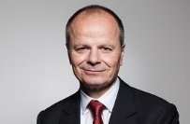
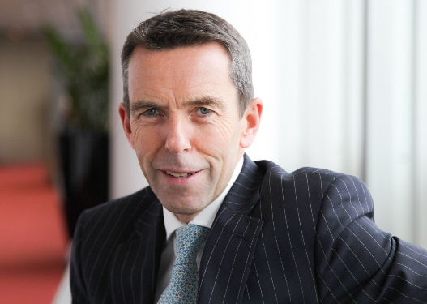
HSBC executive sponsors on how Purple Light Up supports Disability Confidence
Ewen Stevenson, HSBC Group CFO and executive co-sponsor of HSBC’s global Ability Employee Network said: “Having acquired single-sided deafness a few years’ ago, championing disability in the workplace is a very personal cause for me. I am proud to support the work of PurpleSpace and know that our partnership moves HSBC closer to becoming a more inclusive and disability confident employer. Looking forward to participating in #PurpleSpaceLightUp again this year and will be encouraging my team and others across the bank to get involved in this important campaign.”
Ian Stuart, Chief Executive for HSBC UK and executive co-sponsor of HSBC’s global Ability Employee Network said: “A diverse, inclusive workforce makes for a good and sustainable business, and we’re proud to work with PurpleSpace to raise awareness of the valuable contribution that people with disabilities make to the workplace. We want HSBC to be a place where people of all abilities are valued and able to reach their full potential, and where all our customers feel comfortable and supported when banking with us.

Slide 9

#PurpleLightUp: https://www.purplespace.org/purple-light-up
PurpleSpace website: www.purplespace.org
Email: hello@purplespace.org
Twitter: @mypurplespace
LinkedIn: linkedin.com/company/purplespace
Facebook: facebook.com/mypurplespace
Building disability confidence from the inside out

